Slide 1
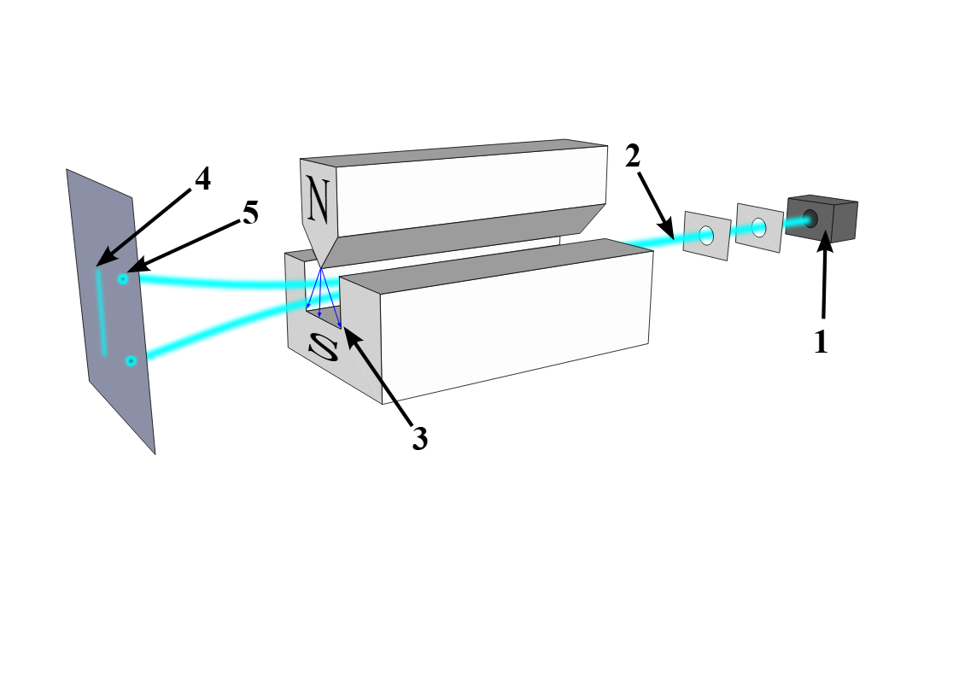
Quantum Spin
Rahul Kumar Vidit Prashant Gala
252is029 252is012

Slide 2
Stern–Gerlach Experiment
A beam of atoms passed through a magnetic field splits into two separate spots instead of forming a continuous line.
Conclusion: Nature at microscopic scale behaves discretely , not continuously.

Slide 3
What is Spin?
Applications:
MRI works because:
Hydrogen nuclei have spin ,Body images are created by measuring the magnetic response of hydrogen nuclei aligned within a strong field.
MRAM:More energy-efficient
Quantum Cryptography
Spin is fundamental Quantum property of particle. It behaves mathematically like angular momentum of a particle.
Electrons behave like tiny magnets. When measured, their magnetic orientation can only have two outcomes(if we measures in vertical basis):
Spin Up (N)
Spin Down (S)
Nothing in between.
This property is quantized, meaning it does not vary continuously.

Slide 4
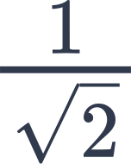
Measurements of Spin
Goal: Stop Eavesdropping
Measurement changes it
You cannot measure without disturbing it
⟨↑| = [1 0] can be also called as North/Up
⟨↓| = [0 1] can be also called as South/Down
⟨ —>| = [ 1 1] can be also called as East/Right
⟨ ←| = [ 1 -1] can be also called as West/Left
Quantum Measurement:
|ψ⟩ = c₁ |↑⟩ + c₂ |↓⟩
State collapses to either |↑⟩ or |↓⟩
Probability of |↑⟩ is | c₁|²
Probability of |↓⟩ is | c₂|²

Slide 5
Measuring Spin in Different Directions
Given a spin lets say: |ψ⟩ = 1 ⟨↑| + 0 ⟨↓|
Probability of ⟨↑| is 1, Probability of ⟨↓| is 0
If we measure this vector in the horizontal direction, we will get ?

Slide 6
Given : ∣ψ⟩=1∣↑⟩+0∣↓⟩
means it is UP :∣ψ⟩=∣↑⟩
Vertical Basis:
∣↑⟩=[1 0​]^{T} and ∣↓⟩=[0 1​]^{T}
Horizontal basis:
∣→⟩=1/√2 ​[1 1​]^{T} and ∣←⟩= 1/√2 [1 −1​]^{T}
Step1:
Express Up State in Horizontal Basis
Lets say ∣↑⟩= x1​ ∣→⟩ + x2​ ∣←⟩
step 2:
Now substitute the vectors.
[1 0​]^{T}=x₁ [1/√2 1√2]^{T} + x₂[1/√2 -1/√2]^{T}
[1 0​]^{T} = 1/√2 ​[x₁​+ x₂ ​x₁​− x₂​​]^{T}
^{Step3 :}
^{Equate Components:}
[1 0]^{T} = [( x₁+x₂)/√2 ( x₁-x₂)/√2]^{T}
x₁ = 1/√2, x₂ = 1/√2
Final Expression:
∣↑⟩=1/√2 ∣→⟩ +1/√2 ∣←⟩
P(→)=​1/2 and for left also 1/2
Hence,If we measure spin in horizontal direction, starting from Up state:
50% chance of Right
50% chance of Left
​

Slide 7
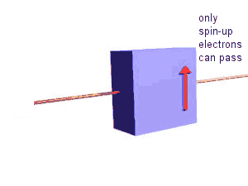
Measuring Spin in Same Direction
Given a spin lets say:
|ψ⟩ = 1|↑⟩ + 0|↓⟩
Probability of |↑⟩ is 1 (100%) and for |↓⟩ is 0
If we measure this same vector again in the same direction, the result will be the same only.
Eg: Vertical → Vertical → Vertical
Result: Always identical (in this case always 1 for |↑⟩)

Slide 8
Three Measurements in a Row:
Vertical → Horizontal → Vertical
We consider the sequence:
Assume the first result is Up.
Sol^{n}:
Initially ∣ψ⟩=∣↑⟩
Since if we measures this vertically i.e. same direction and the state collapses to:
∣ψ⟩=∣↑⟩
Now we measure in horizontal basis.
∣↑⟩=1/√2 ∣→⟩ +1/√2 ∣←⟩
Suppose the second measurement gives(collapse to a single state):
∣ψ⟩=∣←⟩ { P(→)=½ P(←)=½ } ​
If we measure for the third time this vector but now in vertical direction, we will get result as:
∣ψ⟩=1/√2 ∣↑⟩+ 1/√2 ​∣↓⟩ ………………………….(1)
Thus, we see that the result is not same as the previous state.
First vertical gives Up.Second horizontal gives Left or Right(with 50-50%). Now, if we measure this vector in vertical direction, we will get up(with 50 -50 probability).
Means total P(up) =50% { |1/√2|² =½ (50%) from eq. 1}

Slide 9
Measurement Collapse
Before measurement → superposition
After measurement → single state
State vector jumps to basis vector
This is called wavefunction collapse.

Slide 10




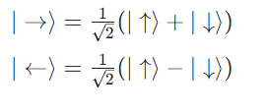
Question 1
Given quantum state representation of Vector V in horizontal basis, express the vector in vertical bases.
Solution:
Substitute the vertical basis equivalents into the equation:
|V⟩ = 1 ⟨↑| + 0⟨↓|
So ,in vertical basis it is purely Spin Up.

Slide 11
Equivalent State vectors in quantum spin
Two state vectors are equivalent if no measurement can distinguish them.
Consider two states ⟨↑| and -⟨↑| & let their measurement basis be ⟨b₁| and ⟨b₂|
⟨↑| = x₁ ⟨ b₁| + x₂ ⟨ b₂|
-⟨↑| =- x₁ ⟨ b₁| - x₂ ⟨ b₂|
Probability for ⟨b₁| = |x₁|² (in case of ⟨↑|)
Probability for ⟨b₂| = |x₂|² (in case of ⟨↑|)
Probability for ⟨b₁| = |-x₁|² (in case of -⟨↑|)
Probability for ⟨b₂| = |-x₂|² (in case of -⟨↑|)
Thus, we say that ⟨↑| and - ⟨↑| are equivalent state vectors.

Slide 12
Equivalent State vectors in quantum spin
The concept in equivalent state vectors in quantum spin is that for 2 vectors to be equivalent their probabilities should be same. But this is not the main concept.
Main concept for 2 vectors to be equivalent is that their measurements in horizontal and vertical direction should be the same.
That is:
Say vector |V1| & |V2| should have same horizontal measurement (lets say x₁ and x₂) and same vertical measurement (lets say x₃ and x₄)

Slide 13
Question 2
State 1: 1/√2 ⟨↑| + 1/√2 ⟨↓|
State 2: -1/√2 ⟨↑| + 1/√2 ⟨↓|
State 3: 1/√2 ⟨↑| - 1/√2 ⟨↓|
State 4: -1/√2 ⟨↑| - 1/√2 ⟨↓|
Check if they are equivalent or not?
If we go by the probability logic, all 4 vectors have same probability i.e (50%-50%) for ⟨↑| & ⟨↓|. So all 4 should be equivalent but that's not the case.
Solution:
States 1 & 4 are equivalent (same measurement in both horizontal & vertical direction)
Also States 2 & 3 are equivalent (same measurement in both horizontal & vertical direction)

Slide 14
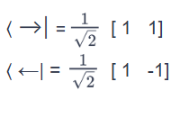
Question 2
State 1: 1/√2 ⟨↑| + 1/√2 ⟨↓|
State 2: -1/√2 ⟨↑| + 1/√2 ⟨↓|
State 3: 1/√2 ⟨↑| - 1/√2 ⟨↓|
State 4: -1/√2 ⟨↑| - 1/√2 ⟨↓|
Check if they are equivalent or not?
Solution(Continue):
Now, let's check for State 1 & 3:
State 1 in horizontal direction:
1/√2[1 0] + 1/√2[0 1] = x₁ [1/√2 1/√2] + x₂[1/√2 -1/√2]
After solving, we find that x₁ = 1, x₂ = 0
State 3 in horizontal direction:
1/√2[1 0] - 1/√2[0 1] = x₁[1/√2 1/√2] + x₂[1/√2 -1/√2]
After solving, we find that x₁ = 0, x₂ = 1

Slide 15
Question 2
State 1: 1/√2 ⟨↑| + 1/√2 ⟨↓|
State 2: -1/√2 ⟨↑| + 1/√2 ⟨↓|
State 3: 1/√2 ⟨↑| - 1/√2 ⟨↓|
State 4: -1/√2 ⟨↑| - 1/√2 ⟨ ↓|
Check if they are equivalent or not?
Solution(continue):
Thus, we find that State 1 and State 3 have different measurements in horizontal direction and hence, they are not equivalent.
Similarly, State 2 and State 4 are also not equivalent.
Hence, State 1 and State 4 are equivalent. State 2 and State 3 are equivalent.

Slide 16
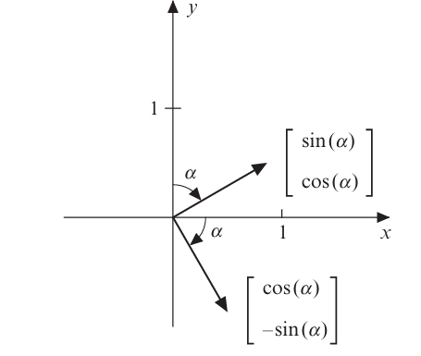

Rotation of Measurement
Angle α is the Basis angle - The angle the state vectors / basis vectors rotate in Hilbert space (math space)
Angle θ is the Apparatus angle - The angle you rotate the measuring device (magnets / detector)
Quantum states can be rotated using a rotation matrix:
R(α) =
If α = 90°, then R(90) 0 = [0 -1] &
R(90) 1 = [1 0]

Slide 17
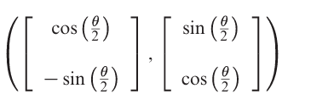
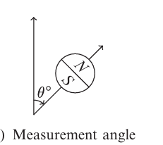
Relation b/w apparatus & basis angle
The relation between apparatus angle and basis angle is that θ = 2α
R(θ) =
Notes:
Hello this is vidit

Slide 18


Question 3
What will be the measurement after we rotate the apparatus through 60°
Rotating the Apparatus through 60° (θ = 60)
Solution:
We know:
R(θ) =
∴
∴

Slide 19

Question 3
What will be the measurement after we rotate the apparatus through 60°
Solution(continue):
If we measure this vector in N direction:
Probability of N = |√3/2|² = ¾ ( 75%)

Slide 20
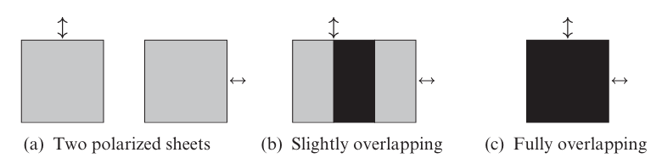
Photons & Polarization
Photon polarization behaves exactly like spin
Consider 2 filters:
1st filter is 0°(vertical) = [1 0]
2nd filter is 90°(horizontal) = [0 1]
Projection = ⟨ H | V⟩ = 0
No photon(light) will pass through both the filters

Slide 21
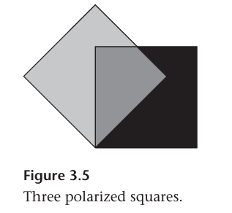
Three Polarizer Experiment
Consider 3 filters:
1st filter is at 0°(vertical) = [1 0]
2nd filter is at 45°:
⟨b₁| = [1 -1] , ⟨b₂| = [1 1]
3rd filter is at 90°(horizontal) = [0 1]
Photons that pass through the first filter will be in state = [1 0]
Probability of passing through 2nd filter is 50% (1/2)
After 2nd filter, state is: ⟨b₁| = [1 -1]

Slide 22
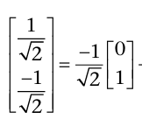
Three Polarizer Experiment
Third filter basis is at 90°:
⟨H| = [0 1]
Projection onto the 3rd filter pass direction:
⟨H | b₁⟩ = - as
Thus, probability of passing through 3rd filter is 50%.
Overall probability = ½ * ½ * ½ = ⅛
Only 12.5% of photons will pass through the setup

Slide 23
Thank You
Rahul Kumar Vidit Prashant Gala
252is029 252is012

Slide 24
Reference
Quantum Computing for Everyone (Book by Chris Bernhardt)

